Slide 1
The STS as reference source
Co-alignment Procedure
How to co-align and co-phase SPICA_VIS with CHARA?
CHARA Reference Source not usable → Necessary use of the STS
BEAM COMBINATION LABORATORY
SPICA_VIS
Spectrograph
VISIBLE TABLE
CHARA Reference Sources
CHARA Reference Source Direction
IR TABLE 2
CLIMB CLASSIC…
IR TABLE 1
MIRC, SPICA-FT…
IR
METROLOGY
TABLE
SPICA_VIS
Before Fiber Units
VISIBLE TABLE
VIS
SPICA_VIS
Feeding Optics
STS
STS Sources Direction
Stéphane Lagarde/Denis Mourard
SPICA-VIS Design Review, July 23-24, 2020

Slide 2
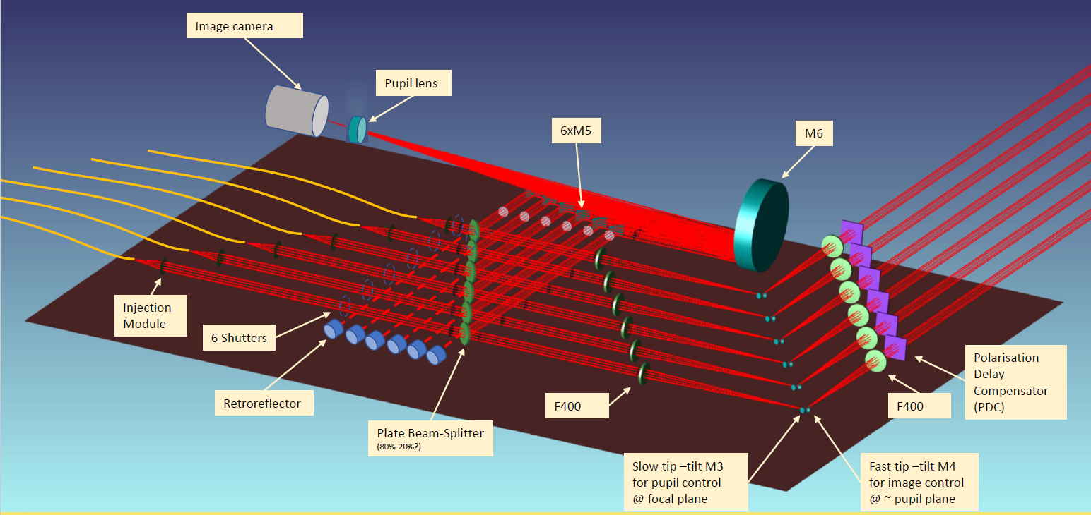
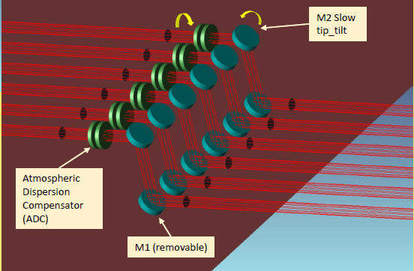
The SPICA adjustment modules
Co-alignment Procedure
ANGULAR ADJUSTEMENT MODULES
Specification: Accuracy < 10as
BCS-BCD
BCS-PIS
SFO-IMG
(Image Adjustment)
BCS-FOM
BCS-BCC
CHARA VISIBLE TABLE
SFU-SDL
(SPICA Delay Lines)
ADC
(Atmospheric Dispersion Compensator)
SHU
PDC
(Polarization Delay Compensator)
BFO-RFL
BAS-COL
BAS-FOC
SFO-FOP
(Feeding Optics)
BFO-BSP
BAS-PUP
(Pupil Adjustment)
BAS-TTT
(Tip/Tilt Tracker)
Stéphane Lagarde/Denis Mourard
SPICA-VIS Design Review, July 23-24, 2020

Slide 3
The SPICA adjustment modules
Co-alignment Procedure
LATERAL ADJUSTEMENT MODULES
Specification: Accuracy < 1mm
BCS-BCD
BCS-PIS
BCS-FOM
BCS-BCC
SFO-IMG
(Image Adjustment)
CHARA VISIBLE TABLE
SFU-SDL
(SPICA Delay Lines)
ADC
(Atmospheric Dispersion Compensator)
SHU
PDC
(Polarization Delay Compensator)
BFO-RFL
BAS-COL
BAS-FOC
SFO-FOP
(Feeding Optics)
BFO-BSP
BAS-PUP
(Pupil Adjustment)
BAS-TTT
(Tip/Tilt Tracker)
Stéphane Lagarde/Denis Mourard
SPICA-VIS Design Review, July 23-24, 2020
Notes:
bras de levier 30mm, picometer actuators 8301 Newport accuracy 30nm => 0.4as << spec = 10as

Slide 4
The SPICA adjustment modules
Co-alignment Procedure
OPD ADJUSTEMENT MODULES
Specification: Accuracy < 7µm
BCS-BCD
BCS-PIS
BCS-FOM
BCS-BCC
SFO-IMG
(Image Adjustment)
CHARA VISIBLE TABLE
SFU-SDL
(SPICA Delay Lines)
ADC
(Atmospheric Dispersion Compensator)
SHU
PDC
(Polarization Delay Compensator)
BFO-RFL
BAS-COL
BAS-FOC
SFO-FOP
(Feeding Optics)
BFO-BSP
BAS-PUP
(Pupil Adjustment)
BAS-TTT
(Tip/Tilt Tracker)
Stéphane Lagarde/Denis Mourard
SPICA-VIS Design Review, July 23-24, 2020
Notes:
PUP (TBC) : bras de levier 20mm, focale du focalisateur et du collimateur, picometer actuators 8301 Newport accuracy 30nm => 0.6µm !!! << 1mm

Slide 5
The SPICA adjustment modules
Co-alignment Procedure
THE SPICA BEAM CONTROL SYSTEM
Specification: Sampling
Image: 3pixels per λ/D
Pupil: 40pixels
BCS-BCD
BCS
(Beam Control System)
BCS-PIS
BCS-FOM
BCS-BCC
SFO-IMG
(Image Adjustment)
CHARA VISIBLE TABLE
SFU-SDL
(SPICA Delay Lines)
ADC
(Atmospheric Dispersion Compensator)
SHU
PDC
(Polarization Delay Compensator)
BFO-RFL
BAS-COL
BAS-FOC
SFO-FOP
(Feeding Optics)
BFO-BSP
BAS-PUP
(Pupil Adjustment)
BAS-TTT
(Tip/Tilt Tracker)
Stéphane Lagarde/Denis Mourard
SPICA-VIS Design Review, July 23-24, 2020
Notes:
SDL : Newport 25mm MFA-PPD resolution = 0.1µm, typical accuracy = 0.9µm, guaranteed accuracy = 3µm << spec

Slide 6
The co-alignment procedure
Co-alignment Procedure
1
Find the reference axis of SPICA
b) Determination of the image and pupil reference positions
CHARA (STS_VIS)
BCS-PIS
BCS-BCD
BCS-BCC
SFO-IMG
BCS-FOM
SFO-FOP
SFU
FBI
BFO-BSP
BAS-TTT
SPICA AXIS
BAS-PUP
a) Back Illumination of the fiber
BFO-RFL
Stéphane Lagarde/Denis Mourard
SPICA-VIS Design Review, July 23-24, 2020

Slide 7
The co-alignment procedure
Co-alignment Procedure
2
Co-align SPICA and CHARA
a) Illumination of SPICA by the STS source
b) Comparison between image and pupil positions and the references
CHARA (STS_VIS)
BCS-PIS
BCS-BCD
BCS-BCC
SFO-IMG
BCS-FOM
SFO-FOP
SFU
FBI
BFO-BSP
BAS-TTT
SPICA AXIS
CHARA AXIS
BAS-PUP
BFO-RFL
c) Adjustment of the beam the angular and lateral
Stéphane Lagarde/Denis Mourard
SPICA-VIS Design Review, July 23-24, 2020

Slide 8
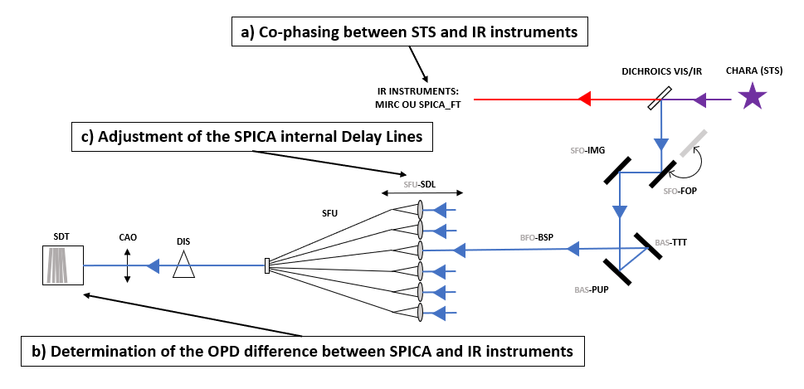
a) Co-phasing between STS and IR instruments
DICHROICS VIS/IR
CHARA (STS)
IR INSTRUMENTS:
MIRC OU SPICA_FT
c) Adjustment of the SPICA internal Delay Lines
SFO-IMG
SFU-SDL
SFO-FOP
SFU
SDT
CAO
DIS
BFO-BSP
BAS-TTT
BAS-PUP
b) Determination of the OPD difference between SPICA and IR instruments

Slide 9
